Slide 1
מפגש פורום היחידות לביואינפורמטיקה נובמבר 2019 טכניון
Personal HPC cluster on Amazon cloud for bioinformatics workflows
Now at your fingertips.
Bioinformatics Core Facility [National Institute for Biotechnology in the Negev]
Notes:
שלום אני לירון מהיחידה לביואינפורמטיקה של המכון הלאומי לביוטכנולוגיה בנגב באוניברסיטת בן גוריון – היחידה של ורד כספי
קודם כל ברוכים הבאים, אני שמח שבאתם
והיום אני הולך להציג בפניכם את Microbe-Flow תהליך עבודה או WF לאנליזה גנומית, אפדימיולוגית ופטוגנומית של נתוניNGS של חיידקים כדוגמא לסוגי תהליכי העבודה שאפשר ליצר בעזרת NeatSeq-Flow

Slide 2
About Us
Eyal Estrin, Cloud Architect, IUCC
Dr. Liron Levin, Bio-Informatician, Ben-Gurion University

Slide 3
Why to use the cloud??
When you don’t have access to a university cluster.
When the entry price for using the university cluster is to high.
When you need a resource that is not available in your cluster.
When you have the money but not the time.
When you want flexibility that you can’t get in your cluster.

Slide 4
IUCC and Cloud Services
Easy access to public clouds (AWS, Azure, Google Cloud Platform), without credit card
Budget and research grant without expiration date
Budget control (monthly reports, notification alerts)

Slide 5
IUCC and Cloud Services – Cont.
1st level support (CloudSupport@iucc.ac.il)
Assistance deploying new research environments
Assistance from solutions architect from the cloud vendors and from partners of the cloud vendors
Knowledge Center:
Wiki (https://public-wiki.iucc.ac.il/index.php/Cloud)
Blog (https://www.iucc.ac.il/cloud/)
Weekly updates (https://www.iucc.ac.il/en/category/weekly-cloud-digest-en/)

Slide 6
Using Cloud Services Trough IUCC
Fill in a form:
https://www.iucc.ac.il/en/cloud-form/
Receive price proposal via email
Send price proposal to University purchase department and ask to prepare purchase order for IUCC
Send the purchase order to invoices@iucc.ac.il
Begin working with your account in the cloud

Slide 7
Cost Model without commitment
On Demand / Pay as you go
Pay for compute capacity by the hour or second (minimum of 60 seconds) with no long-term commitments
Spot Instances
Request spare computing capacity for up to 90% off the On-Demand price

Slide 8
Architecture (in high level)
Build and use on-demand
Use scripts to build an HPC cluster from scratch
Elastic scale
Set initial cluster size, and maximum number of compute nodes (scale out as needed)
Set VM instance type according to research needs
Choose an HPC scheduler according to need and familiarity (Slurm, SGE, etc.)

Slide 9
Using the cloud as you use your HPC cluster
Use a job scheduler like you use in your HPC
Use a single high performance computer.
Access using SSH.
SSH
Low cost entry point computer
Job scheduler
High performance NODE computer instance

Slide 10
Differences in using the cloud as your HPC cluster
One command to activate a computing NODE
Jobs can be send only if at least one NODE is active.
NODEs will be deactivated automatically if not in use.
NODEs will be activated automatically if jobs are waiting for too long.
One command to deactivate all computing NODEs.
It takes a few minutes for a NODE to be active.
It takes a few minutes for a NODE to deactivate.

Slide 11
Test case: Running bioinformatics workflows using NeatSeq-Flow
We used the SGE job scheduler like we use in BGU HPC.
We chose to use a 64 core with 256GB of RAM as our NODE instances.
We chose to use a low cost 2 core with 4GB of RAM as the entry point computer.
SSH
SGE
Job scheduler

Slide 12
Test case: Running bioinformatics workflows using NeatSeq-Flow
We created a installation script to install:
CONDA
NeatSeq-Flow using CONDA
Firefox
Some settings for X11-forwarding
All bioinformatics programs that we need for the workflows were installed using CONDA.

Slide 13
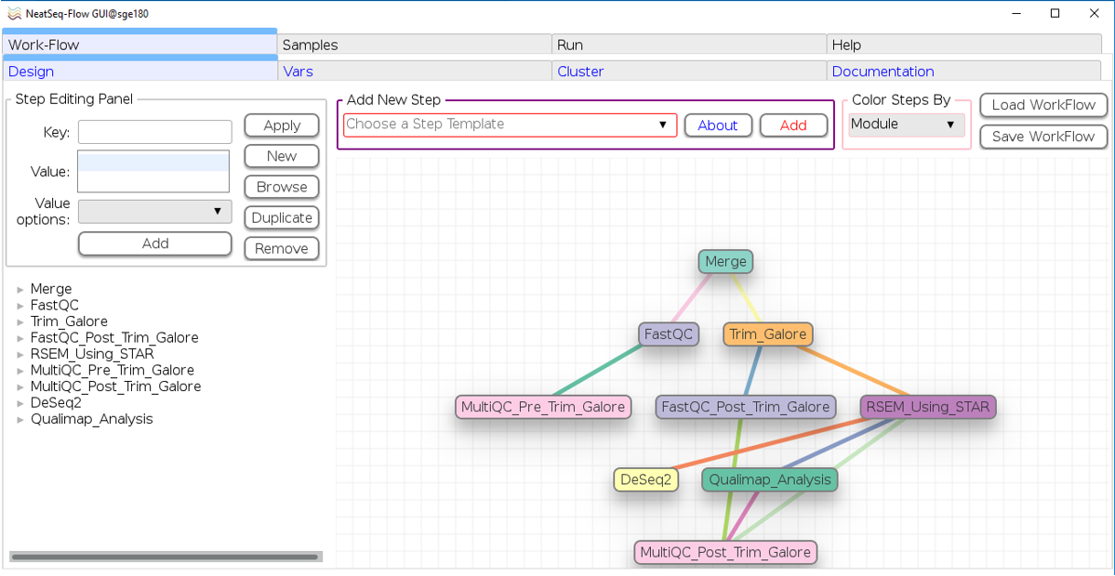
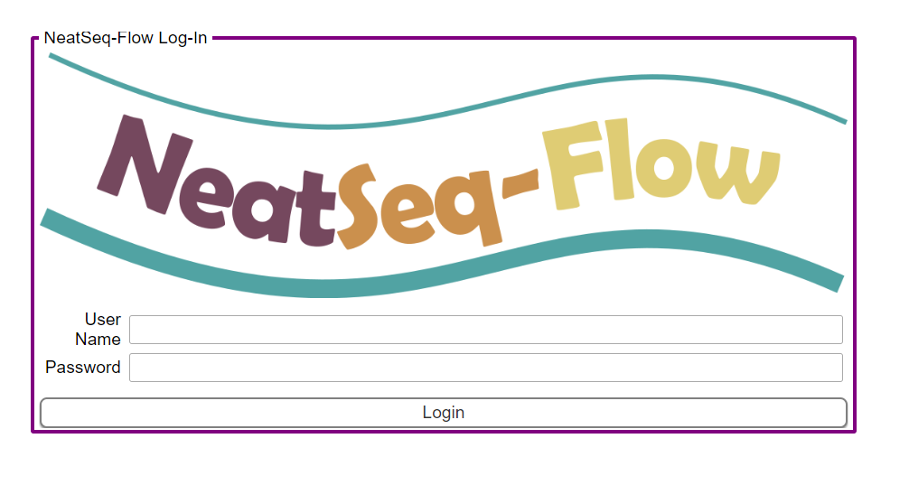
Test case: Running bioinformatics workflows using NeatSeq-Flow
Interface options:
Command Line
Desktop app running from the terminal
Browser app running as a server

Slide 14
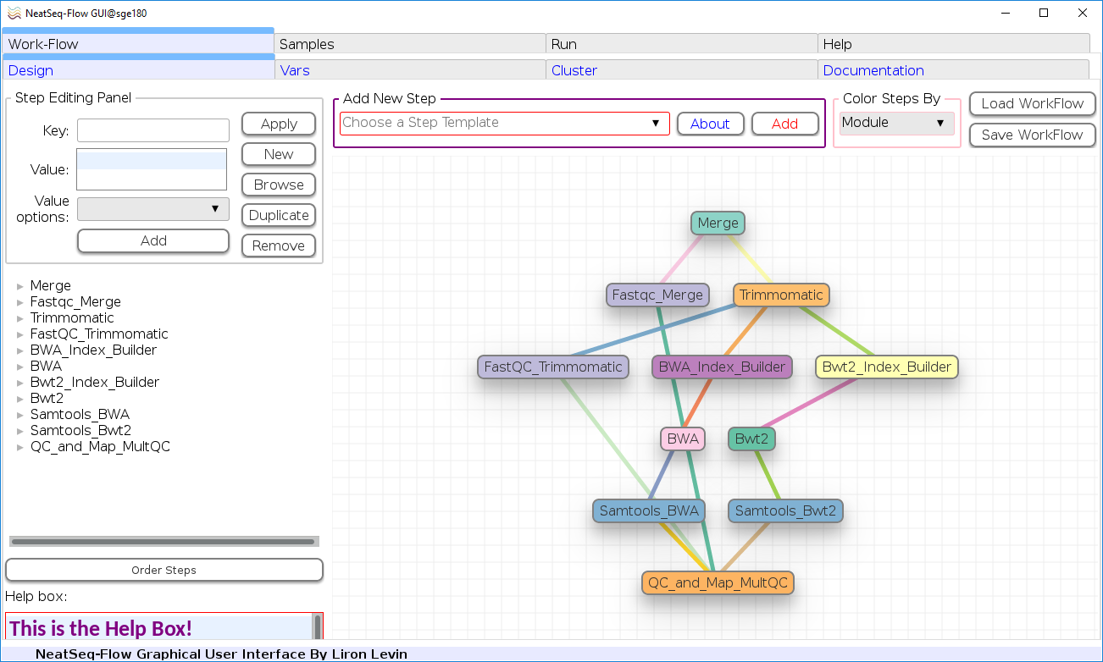
Test case: Running bioinformatics workflows using NeatSeq-Flow
Frist Try:
Our Tutorial test run
First (and only) problem:
Due to the cloud storage system, problems in parallel writing to files.
Solution:
NeatSeq-Flow code was updated to lock files.

Slide 15
Test case: Running bioinformatics workflows using NeatSeq-Flow
24 Bacterial Samples
Paired-end 36bp
~4M*2 reads per sample
Reference genome : Staphylococcus aureus ~2.8Mp
All in ~30 min including ftp download and decompression

Slide 16
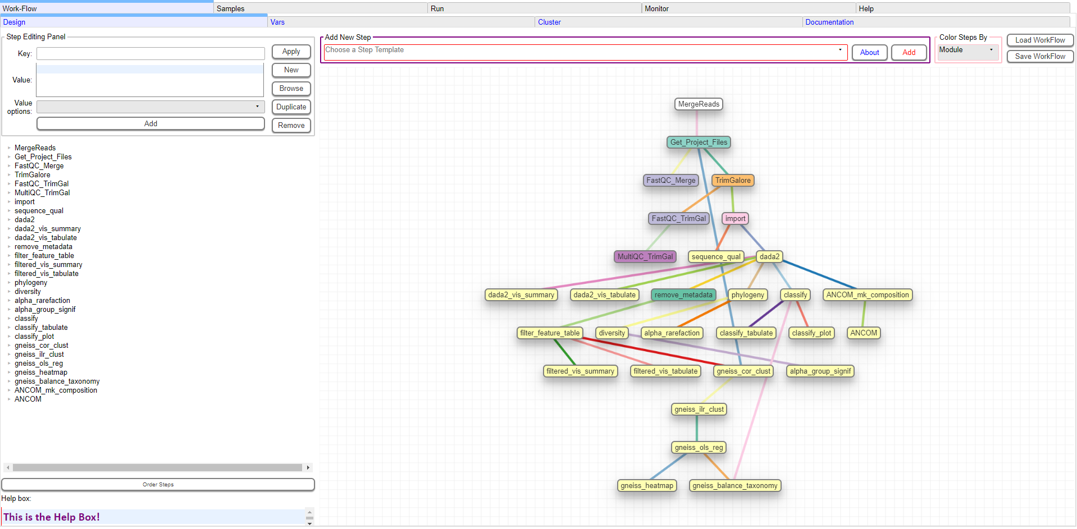
Test case2 - QIIME2: Running bioinformatics workflows using NeatSeq-Flow
Data from C. Lavoie et al 2018
81 16s Samples
Paired-end
All in ~44 min including decompression

Slide 17
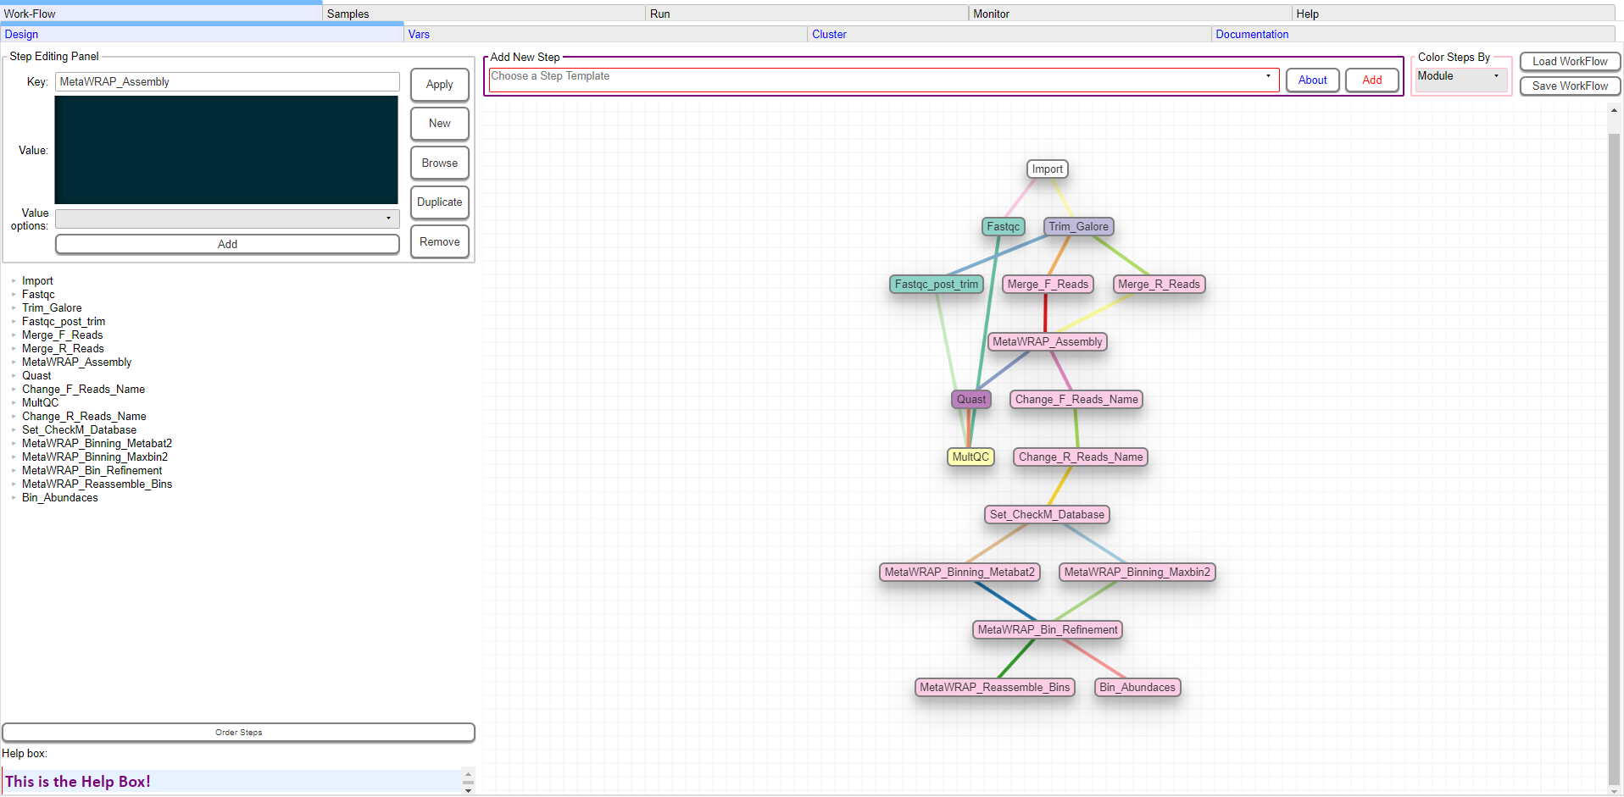
Test case3 - MetaWRAP: Running bioinformatics workflows using NeatSeq-Flow
Data from metaHIT gut survey (as in the MetaWRAP tutorial)
3 Samples
Paired-end
All in ~3h including decompression

Slide 18
For more details
IUCC Cloud Services | NeatSeq-Flow

