Slide 1
Azure - HPC

Slide 2
What is HPC all about?
Uses:
Science and research
Genomics & bioinformatics
Climate modeling
... and much more!
APP
Many individual tasks need to run to reach the answer
Use many computers/
VMs instead of one
Tasks are assigned
to computers/VMs
Independent or
coupled tasks
INPUT
OUTPUT
Data is read, computed

Slide 3
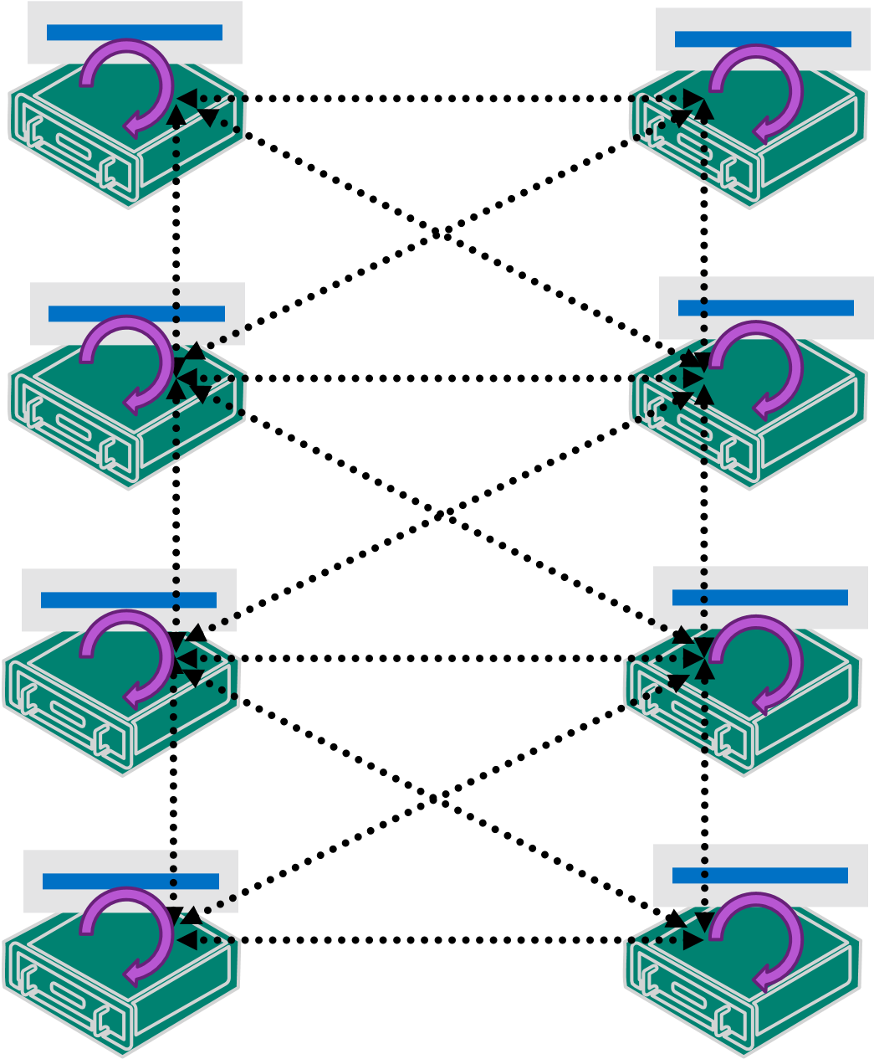
Two main types of HPC workloads
Embarrassingly parallel:
  Nodes don’t need to talk to each other, or very little cross-node communication
  Usually a parameter sweep, a job splitting, or a search/comparison through data
Tightly coupled:
  Nodes need to talk to each other constantly
  Requires a fast interconnection network (low latency and high throughput)
Notes:
Parallel:
Monte Carlo simulations, image/video rendering, genetic algorithms, sequence matching
Coupled:
automotive crash simulation, fluid dynamics, climate modeling, reservoir simulation, manufacturing modeling

Slide 4









HPC in Azure- Azure adds value to HPC workloads
Most performant infrastructure
Open & Integrated
Granular cost control & Governance
Fastest HPC and GPU instances in the Cloud
Specialized instances for AI Training, Remote visualization, Accelerated Analytics
Only cloud providing ultra-fast, low latency networking with RDMA and Infiniband
Azure capabilities for easily deploying and managing scale for large, parallel jobs
Industry specific
Flexible consumption and cost savings with low-priority VMs on Azure
Per-minute billing for VMs
Granular insights into HPC usage & costs helping with workload optimization
Built-in policy based governance for richer collaboration
Largest global footprint & compliance portfolio of any cloud
Life Sciences
Finance
Manufacturing
Software & Hardware
Languages
Operating Systems
Infrastructure

Slide 5

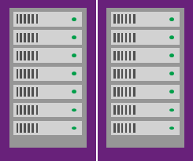
HPC in Azure: VMs with RDMA, GPU, FPGA + Cray
A
A
D
F
G
A
D
G
D
F
G
F
Highest
value
Highest
value
A
SSD Storage
Fast CPUs
Compute
Optimized VMs
Most memory
fastest CPUs
>80,000 IOPs
Premium Storage
>80,000 IOPs
Premium Storage
Low latency, high throughput apps
Entry Level VMs
Dev/Test Workolads
General Purpose VMs
Common Applications, Web servers etc
Compute Optimized VMs
Gaming, Analytics
Large Memory VMs
Large Databases
A
D
F
G
Highest
value
H
L
N
Infiniband
A
Highest
value
High
Performance VMs
SSD Storage
Fast CPUs
Storage
optimized VMs
Compute
Optimized VMs
GPU-enabled
VMs
Most memory
fastest CPUs
SAP HANA
sizes
>80,000 IOPs
Premium Storage
L
L
H
N
H
N
Fastest VMs on Azure with Intel Haswell E5 processor
Supports RDMA
and high memory
For high performance,
fluid dynamics
Based on Intel Xeon
E5 processor
Supports 8GB RAM and
768 GB to 6TB SSD
For Low latency, Storage Optimized workloads
NVIDIA Tesla accelerated
platform and GRID 2.0
Supports RDMA
For Compute and Graphics intensive workloads
Available with
G and D series
Highest
value
A
Cray in Azure
Aries Connected CPU/GPU/Storage available in cloud
Doubling our Compute Instances Portfolio
Storage optimized VMs
No SQL Databases (Cassandra, MongoDB), Data warehousing
High Performance VMs
Batch processing, fluid
dynamics, monte
carlo simulation
GPU-enabled VMs
NV -Graphic based applications
NC2 – Advanced Sim (P100-X)
ND1 – AI Inferencing (P40)
ND2* – AI Training (V100/V100 SXM)
FPGA*
Virtual Machines – HPC
FPGA Microservices – AI/Edge
Highest
value
Largest machines supporting Enterprise grade workloads

Slide 6
Agility: Cost-Performance Improves Over Time
Edit Master text styles
  Second level
    Third level
      Fourth level
        Fifth level
Internal Server
Performance
4 year Purchased Server
Year 3
Year 4
Cloud VM
Performance
Year 2
Year 1

Slide 7
Agility: Manage cost with Low-priority VMs
Cheaper compute:
  Up to 80% discount; fixed price
Uses surplus capacity:
  Availability can vary; can be preempted
Compare to:
  AWS spot instances
  Google Cloud preemptible instances
VM support:
  Virtually all VM sizes
Value:
  Get work done for lower cost, faster, or do more for same price
VMSS support available now
Batch & CycleCloud integration:
  Pools & Clusters can contain both low-priority and dedicated VMs
  If preemption, pool automatically seeks to target to replace preempted VMs
  Interrupted tasks are automatically re-scheduled & re-executed
Suitable Batch jobs:
  Job completion time flexibility
  Shorter tasks

Slide 8
Cloud HPC: Blended Consumption Approach
Meet on-prem needs & costs, with agility and scale capabilities
Scale: Burst using
On-Demand & Low Priority
H, Nc Series
Infiniband Connected,
High Clock Speed/GPU,
Physical Cores
Variable Use
Burst to Large Scale Capacity
For Workloads Beyond
Internal Data Centers
D, E, F, L, G, M
Fixed Use
Agility:
1-Yr Reservation & On-Demand
Wide RAM Ratios:
4-60GB per Physical core
Max Server Memory: 4TB
Fortune 500 User
Ability to Take Advantage of New Compute Capabilities and
Technologies as they Become Available
Cray CS
Blended Cost: Cores & Data
Bare metal clusters:
High GHz CPUs (4.5 Ghz)
Custom Configurations
On-premise HPC
3.92 cents
Cray CS
3.1 cents
Datacenter Move:
Cray CS & 3-yr Reservation
Cray XC
VM-Based 3-yr reserved
3.4 cents
IT Strategy to Simplify Operations,
Best Price-Perf for Dedicated Use
Moving On-Premise HPC to Cloud
Supercomputing
for extreme scale AI/simulation
VM-Based 1-yr reserved
4.1 cents
On-Demand Burst
4.7 cents

Slide 9



Azure Big Compute Platform
HPC End-users, IT Staff, Line of Business
Developers
App Users
Cluster templates to run existing, on-prem HPC applications, schedulers
SaaS / Client
Solution
Azure
Batch AI
Parallel R
VFX Plug-Ins
Azure CycleCloud
Hybrid & Cluster Manager for HPC/AI
Azure Batch
VM Management & Job Scheduling
Cloud Services, VMs, VMSS
Hardware

Slide 10
Storage Options for HPC workloads
Azure storage:
  Azure blob object storage, with Blob FUSE adapter available for Linux
  Ultra SSD disks for low latency, I/O Intensive workloads
VM-based:
  Single VM with attached disks, Windows or Linux
  Distributed file system; e.g. Lustre, GlusterFS, BeeGFS, etc.
Avere vFXT for Azure
Azure HPC Cache

Slide 11
Introducing Azure HPC Cache
Flexible File System Caching for your computational workloads
High-Performance
Big Scale
Flexible
Simple
High Throughput
Low Latency
Scale-out Performance
Provide continuity to cloud workloads
Burst file data to your applications
Easily enable computational workloads of any size
Choose from three Performance SKUs
Highly-Available Distributed Scale
Flexible Access
Easy to Integrate
Create a hot cache of shared file data
Support 10s or 10s of 1000s of clients/cores
Use your on-prem NAS data, cloud based data, or both in a single namespace
Start in minutes
Use Azure APIs or Portal

Slide 12
When do you use HPC Cache (or vFXT)
Client wants to run HPC workloads against # of clients (10s to 10s of 1000s cores) and….
Customer has on-premises NAS serving NFS data
(NetApp, Isilon)
Data is mostly large files
(>1MB)
Workloads CAN be mixed read/write when larger file
Customer wants to use Blob but needs full POSIX compliance
Customer running a parallel file system on premises but willing to serve that data via NFS gateway
Performance expectations:
Up to:
2GB/s, 4GB/s or 8GB/s

Slide 13

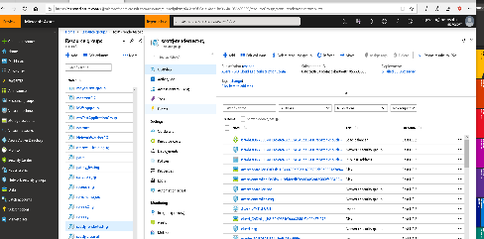
Azure HPC Cache – Service Instance
Azure
subscription
Customer Storage
Account
Compute Cluster
Blob-as-POSIX
Customer Datacenter
Azure Blob Container
/export1
NFS
Mountpoint(s)
Network-Attached Storage
HPC Cache Instance
Create and Manage service instances from the Azure portal/API/ ARM
Azure Service Control

Slide 14


HPC Modernization Made Simple: A Reference Architecture
HPC Cluster
Cloud HPC
Azure CycleCloud
  Best-Practice templates for HPC/file systems
  Orchestrate multi-VM series & sizes
  Use AD to manage access and control cost
Current
Refresh
Cray+ClusterStor FS
Linux Bare-metal
Next
Refresh
1yr / 3yr VM
reservations
Compute
Nodes
Burst Low priority &
On-demand VMs
Avere File Cache
  High perf write-through cache
  Enable massive read scale
  Simplify hybrid data access
Parallel FS
vFXTs
Scheduler
Azure Batch – Cloud Native
  Developer APIs for in-app Cloud HPC
  Scheduler as a Service at Scale
  Easily leverage Azure features like Low-prio
Workstation
Applications
Azure Batch Pools

Slide 15
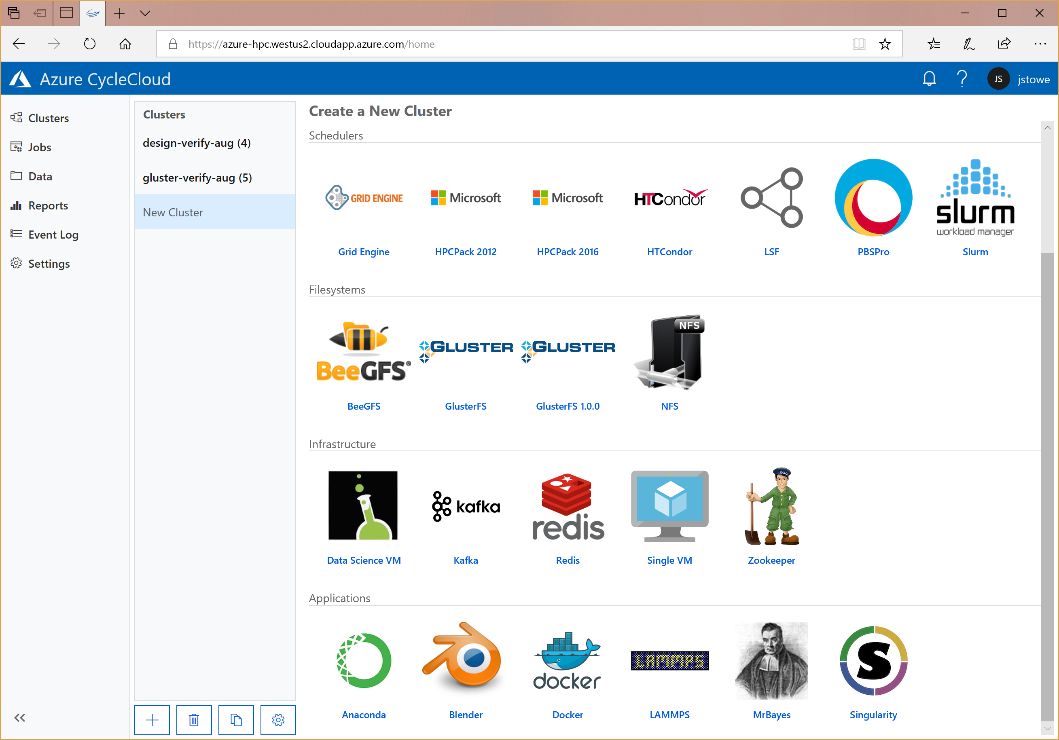
Easy HPC Clusters, at scale, in Azure
Free downloadable tool to manage HPC in Azure, with:
Easy templates for HPC schedulers, file systems, & workloads
Burst/Hybrid for internal HPC workloads, without re-writing
Customers in production today from 100 to 100,000+ cores
Manage access with AD & control/alert for HPC costs
Freely Available Tool in Download Center,
Azure Marketplace, Azure Container Registry

Slide 16



Azure CycleCloud: Easily move & manage cloud HPC
Solution #1: Hybrid / Management
Migrate on-prem HPC workloads as-is
Best-practice HPC templates
Manage both compute & data workflows
Solution #2: Governance/Control
Manage HPC access & authorization
HPC scale & budget control, policies
Compliance, Audit, Reporting
Customer moves existing, strategic compute workloads to Azure
Designer, Engineer,
Data Scientist
User Apps
& Scripts
Nv
H
Work- station
Nc
Line of Business Manager
D, F
Avere
IT/Admin
Existing On-Premise Cluster:
Simulate Products,
AI Prediction
vNet Cluster Template

Slide 17
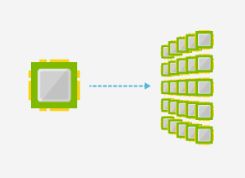
Azure Batch
Rendering
Media transcoding & pre-/post-processing
Test execution
Monte Carlo simulations
Genomics
Deep Learning
OCR
Data ingestion, processing, ETL
R at scale
Compiled MATLAB
Engineering simulations
Image analysis & processing
Enable applications and algorithms to easily and efficiently run in parallel at scale

Slide 18
Azure Batch: HPC Workload Characteristics
Application
E.g. Transcode: ffmpeg.exe –i <input file> -o <output file> -s 1920x1080
E.g. Monte Carlo simulation: simulate –i <iteration params> -o <output file>
E.g. Render: render.exe –i <scene file> -p <project files> -f <frame> -r <tile region> -o <output file>
Job
INPUT
OUTPUT
Tiles
Transcode A
Simulation F
10,000 iterations
Render Movie
.
.
.
.
Transcode B
.
.
Transcode C
.
.
Simulation G
50,000 iterations
.
.
Frames
E.g. 90 mins x 60 secs x 24 frames x 64 tiles
= 8.3 million tasks
= ~ 2 million compute hours
(15 mins per tile)
.
.

Slide 19
HPC Workload Requirements
Queue
Jobs & Tasks
Job scheduling
Applications
VMs
Storage
VM management
E.g. input and output data:
Avere, Blob, Persistent FS

